Slide 1
Mental Health Amongst Agricultural Workers
May 4, 2021
Gladys Carrillo, LCSW
© National Center for Farmworker Health, 2021
Notes:
Developed by the National Center for Farmworker Health, Inc., © 2013

Slide 2
© NCFH 2021

Slide 3
Learning Objectives
Participants will:
Discuss the importance of mental health outreach and integrated services to Migratory and Seasonal Agricultural Workers (MSAWs).
Gain an understanding of the strategies examined in NCFH’s Mental Health Learning Collaborative for integrating behavioral health services.
Learn about mental health resources that can be utilized with MSAWs including, patient education materials, mental health screening tools, and national resources that support mental health outreach.
© NCFH 2021

Slide 4
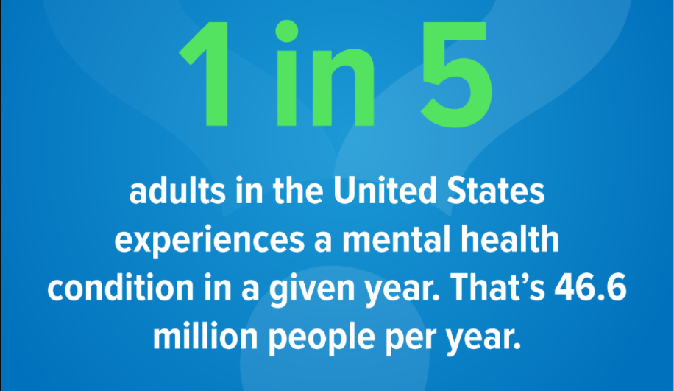
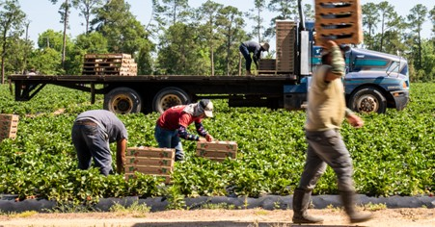
Mental Health in America
© NCFH 2021

Slide 5
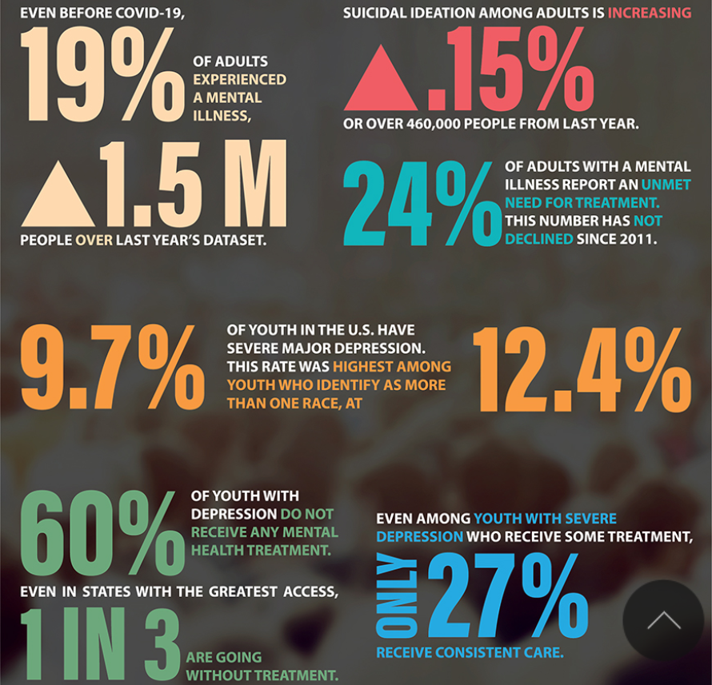
Current State of the Union

Slide 6
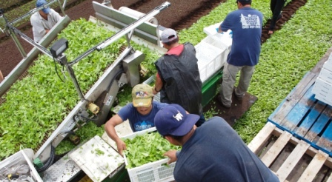
Agricultural Work
© NCFH 2021

Slide 7
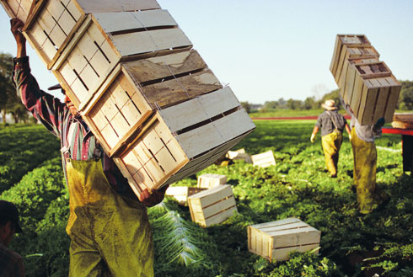
Agricultural Work
Agriculture is consistently ranked as one of the three most dangerous occupations in the nation¹
In 2018, 411 agricultural workers died of work-related injuries²
© NCFH 2021

Slide 8
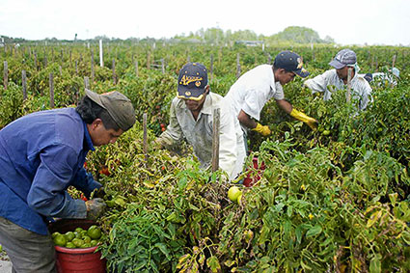
Occupational Risks³
Risks Related to Repetitive Motions & Heavy Lifting
Risks Related to Organization of Work
Risks Related to Farm Machinery/ Tools
Lack of safety precautions implemented in the workplace
© NCFH 2021

Slide 9
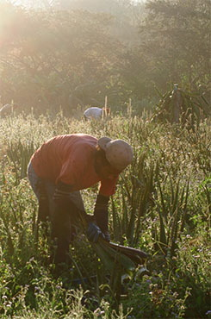
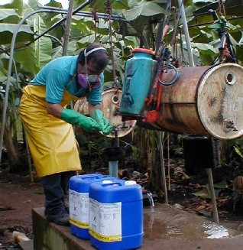
Environmental Risks³
Chemicals/ Pesticides
Weather Plants Animals
Sanitation/ Hygiene
© NCFH 2021

Slide 10
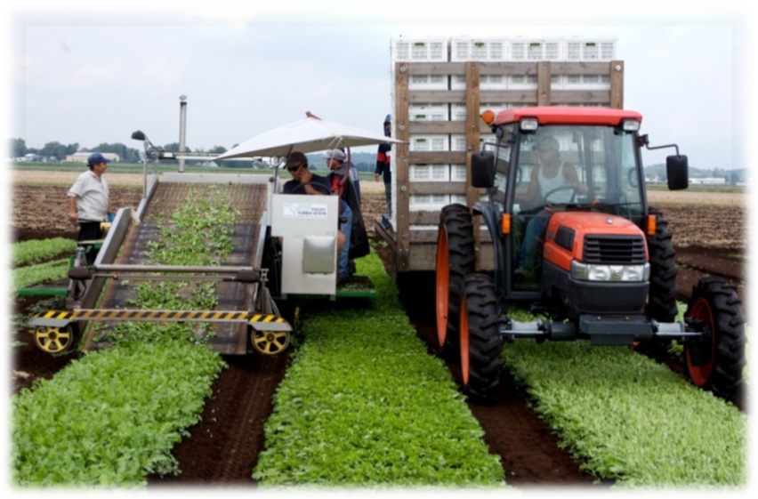
Occupational Health Outcomes
Musculoskeletal injuries & disorders⁴
Injuries from machinery and equipment/tools⁴
Respiratory infections
Pesticide exposure
Heat stress
Insect/rodent/snake bites
Eye injuries
Poor Mental Health⁵
Vulnerable to Labor Trafficking^{6,7}
© NCFH 2021
Notes:
10

Slide 11
Environmental Health Outcomes
Gastro-intestinal diseases
Intestinal parasites
Urinary tract infections
Conjunctivitis
Skin conditions, such as rash & pruritus⁸
Lead poisoning
Respiratory conditions due to mold & allergens⁹
Increased risk for infectious diseases in shared housing, especially COVID-19, influenza, TB, tularemia¹⁰
© NCFH 2021
Notes:
11

Slide 12
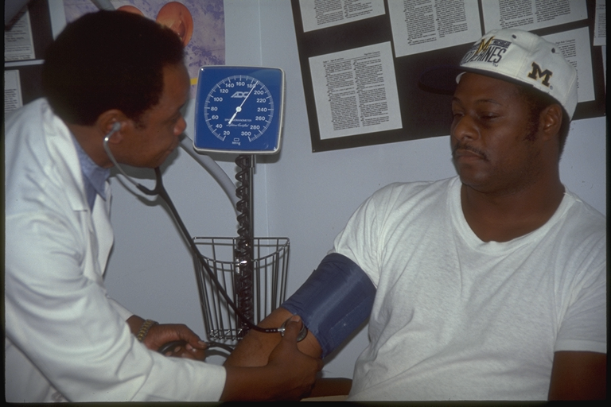
Chronic Conditions¹¹
Allergies
Asthma
Hypertension¹²
Diabetes¹²
Obesity¹²
Cardiovascular disease
Cancer
HIV/AIDS
Tuberculosis
© NCFH 2021

Slide 13
Mental Health Conditions
Sometimes associated with high levels of stress:¹³
Anxiety
Depression
Substance Misuse
Acculturation
Intimate Partner
Violence
Post Traumatic Stress Disorder
© NCFH 2021

Slide 14
Mental Health Stigma²⁴
© NCFH 2021

Slide 15
SDOH Factors
Individual level:¹⁴
Mobility/ Transportation
Financial hardship
Food insecurity
Language barriers
Limited literacy levels
Lack of access to technology
Health beliefs and practices
Unable to navigate health system
Limited access to healthcare services and COVID testing
Increase risk for illness/health conditions
Lack social support and connection to others
© NCFH 2021

Slide 16
SDOH Factors
Systems level:
Labor policies that include lack of paid sick time/time off¹⁴
Community and workplace barriers¹⁵
Limited health care sites¹⁵
Immigration systems & threat of deportation¹⁶
Exclusion from public and private health insurance programs¹⁷
Lack of awareness about challenges faced by agricultural workers among public health officials & health care providers
Lack of adequate education and nutrition programs for children
© NCFH 2021

Slide 17
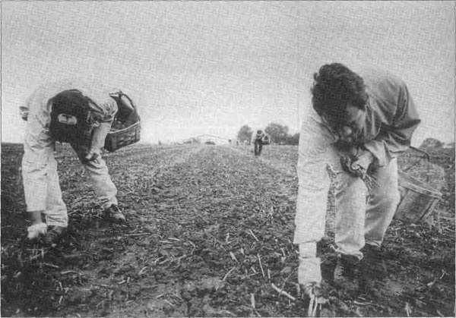
Impact of COVID-19
Amongst agricultural workers^{18,19}:
Increase in mental illnesses related to mood including depression, anxiety, grief, and trauma
Increase in rates of substance use including alcohol and other drugs
Increase in chronic stress at work, especially for “essential workers”
© NCFH 2021

Slide 18
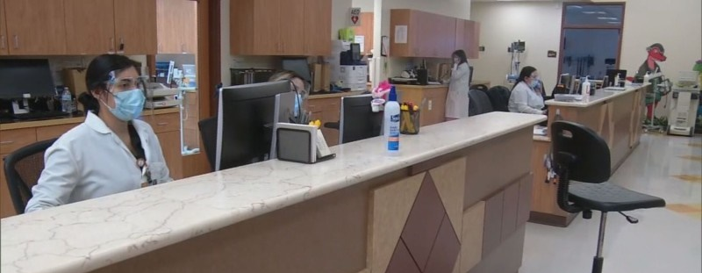
Impact of COVID-19
Amongst Healthcare Workers²⁰:
Increase in mental health concerns as well
Increase in chronic stress at work
Increase in burnout and compassion fatigue
Increase in sleep problems and emotional/physical exhaustion
© NCFH 2021

Slide 19
Mental Health LC
© NCFH 2021

Slide 20
Mental Health LC
Participating members:
Beaufort Jasper Hampton Comprehensive Health Services
Cherokee Health Systems Talbott
Tri-Cities Community Health
Shenandoah Community Health
Golden Valley Health Center
Finger Lakes Community Health
HealthLinc Community Health Center
Sea Mar Community Health Centers
Premier Community Healthcare Group
Yakima Valley Farmworkers Clinic
Avenues Counseling LLC
North Carolina Health Center Association
© NCFH 2021

Slide 21
Mental Health LC
Guest speakers!
© NCFH 2021

Slide 22
Mental Health LC
Learning Sessions
1. COVID and Mental Health Amongst Agricultural Workers
2. Addressing Primary Mental Health Issues Impacting MSAWs
3. Orientation to mental health screening tools
4. Virtual Stream Forum (VSF) session
5. Action Planning for Implementation
(Follow-up to VSF)
© NCFH 2021

Slide 23
Collaborative Care Model
© NCFH 2021

Slide 24
Collaborative Care Model
A team care approach designed to address both mental and physical health conditions.^{20,21}
Five core principals include:
1) Patient centered care;
2) Evidenced-based care;
3) Measure-based treatment;
4) Target population based-care
5) Accountability.
© NCFH 2021

Slide 25
Integrated Care²³
© NCFH 2021

Slide 26
Integrated Care²³
Coordinated Care
Co-located Care
Fully Integrated Care
© NCFH 2021

Slide 27
Clinical Pathways and Perspectives²³
Perspectives
Clinical Pathways
Frameworks that guide and feed integrated care efforts
(Ex: Trauma-Informed Care)
Guide care to ensure that persons with specific conditions receive monitored, timely care
(Ex: Mental Health screening tools like ACE Screenings)
© NCFH 2021

Slide 28
Mental Health Hub
© NCFH 2021

Slide 29
Cultural Considerations
Trust is essential to connecting with this population.
Establish rapport and have genuine interactions
Be open to community settings such as schools and faith-based organizations to provide health information ²³
Practice cultural humility.
Symptoms may manifest differently in different cultures
Be aware of cultural practices and beliefs
Be aware of cultural behaviors
Practice universal precautions when discussing health services.
Limited health literacy
Limited levels of education
Address stigma and reluctance to discuss mental health.
Normalize the connection between physical and mental health
Normalizing stressors (being far from family, long work hours, etc.)
Be mindful of SDOH factors
© NCFH 2021

Slide 30
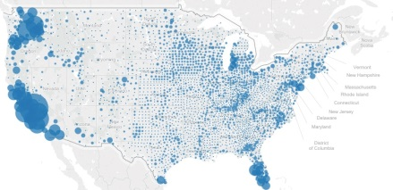
NCFH T/TA Services
Addressing Population Specific Demographics and Identified Needs
Understanding the Population
Fact Sheets & Research
Health Center Learning Collaboratives​
Population
Estimation
Culturally Appropriate Health Education
Patient Education Materials​
Training/ Curricula​
Digital Stories​
Supporting 51% Consumer Board Requirement
Health Center ToolBox​
Board Tools,
Resources &
Templates
Archived Webinars
© NCFH 2021

Slide 31
NCFH Additional Resources
© NCFH 2021
Notes:
​

Slide 32
Ag Worker Access Campaign
© NCFH 2021

Slide 33
Upcoming Webinars!
Diabetes 101, presented by Valeria Mallett, RD, LD, CDCES on May 6.
The Importance of Recognizing and Responding to Toxic Stress in Primary Care Settings, Presented by Dr. Elena Reyes and Dr. Javier Rosado on May 25.
​Ag Worker Health 102: Supporting Agricultural Worker Health, Presented by the Farmworker Health Network on June 3.
© NCFH 2021

Slide 34
© NCFH 2021

Slide 35
Connect with NCFH!
Facebook and Twitter: @NCFHTX
Linkedin: company/national-center-for-farmworker-health-ncfh-/
© NCFH 2021

Slide 36
Thank You!
Gladys Carrillo, carrillo@ncfh.org
National Center for Farmworker Health​
1770 FM 967 | Buda, TX 78610​
Phone: 512.312.2700​
Fax: 512.312.2600​

Slide 37
References
1. U.S. General Accounting Office. 1992. Hired Farmworkers Health and Well-Being at Risk: Report to Congressional Requesters. Washington, DC: U.S. General Accounting Office
2. Bureau of Labor Statistics, Census of Fatal Occupational Injuries, https://www.bls.gov/iif/oshwc/cfoi/cftb0322.htm
3. Hansson, S. (2014). Occupational risks in agriculture. https://link.springer.com/referenceworkentry/10.1007%2F978-94-007-0929-4_318
4. Northeast Center for Agricultural & Occupational Health. Farmworker Clinical Care Resource. http://www.farmworkercliniciansmanual.com/index.php/common-health-conditions/muscle-strain/
5. Quandt S, Kucera KL, Haynes C, et al. (2013). Occupational health outcomes for workers in the agriculture, forestry and fishing sector: Implications for immigrant workers in the southeastern US. https://www.migrantclinician.org/files/3%20Quandt%20et%20al%20Occupational%20health%20outcomes.pdf
6. Izcara Palacios SP & Yamamoto Y. (2017). Trafficking in US agriculture. https://onlinelibrary.wiley.com/doi/abs/10.1111/anti.12330
7. Human Rights First. Exploitation and the private sector. https://www.humanrightsfirst.org/exploitation-and-private-sector
8. Gustafson CJ, Feldman SR, Quandt SA, et al. (2013). The association of skin conditions with housing conditions among North Carolina Latino migrant farm workers. https://onlinelibrary.wiley.com/doi/abs/10.1111/j.1365-4632.2012.05833.x
© NCFH 2021

Slide 38
References
9. Kearney GD, Chatterjee AB, Talton J, et al. (2014). The association of respiratory symptoms and indoor housing conditions among migrant farmworkers in eastern North Carolina. https://www.tandfonline.com/doi/abs/10.1080/1059924X.2014.947458
10. Quandt SA, Brooke C, Fagan K, et al. (2015). Farmworker housing in the United States and its impact on health. https://journals.sagepub.com/doi/abs/10.1177/1048291115601053
11. Boggess B & Ochoa Bogue H. (2016). The health of U.S. agricultural worker families: A descriptive study of over 790,000 migratory and seasonal agricultural workers and dependents. https://muse.jhu.edu/article/617496/summary
12. Lighthall, D. (2001). The poor health of farm workers. https://www.ncbi.nlm.nih.gov/pmc/articles/PMC1071557/
13. The mental health of agricultural workers. (2006). The mental health of agricultural workers. https://link.springer.com/chapter/10.1007/0-387-30105-4_22
15. Schmalzried H & Fleming Fallon L. (2012). Reducing barriers associated with delivering health care to migratory agricultural workers. https://www.rrh.org.au/journal/article/2088
15. Kozhimannil KB & Hennings-Smith C. (2018). Racism and health in rural America. https://muse.jhu.edu/article/686951/summary
16. Hacker K, Anies M, Folb B & Zallman L. (2015). Barriers to health care for undocumented immigrants: A literature review. https://www.ncbi.nlm.nih.gov/pmc/articles/PMC4634824/
17. Portes A & Fernandez Kelly P. (2012). Life on the edge: Immigrants confront the American health system. https://www.ncbi.nlm.nih.gov/pmc/articles/PMC3622255/
© NCFH 2021

Slide 39
References
18.National Alliance on Mental Illness.(2020). The Effects Of COVID-19 Related Social Isolation On The Mental Health Of Racialized Communities. Retrieved December 11, 2020 from https://nami.org/Support-Education/NAMI-HelpLine/COVID-19-Information-and-Resources/COVID_Isolation_Guide.pdf.
19.National Center for Farmworker Health. (2020). Agricultural Workers and Mental Health Factsheet. Retrieved from Mental Health - NATIONAL CENTER FOR FARMWORKER HEALTH (ncfh.org).
20. Mental Health America. (2020). The Mental Health of Healthcare Workers in COVID-19. Retrieved December 11, 2020 from https://mhanational.org/mental-health-healthcare-workers-covid-19.
21.University of Washington. (2020). AIMS Center: Collaborative Care Implementation Guide. Retrieved December 11, 2020 from https://aims.uw.edu/resource-library/collaborative-care-implementation-guide.
22. University of Washington. (2020). AIMS Center: Principles of Collaborative Care. Retrieved December 11, 2020 from https://aims.uw.edu/collaborative-care/principles-collaborative-care.
23.Rosado, J.I., (March 2021). Florida State University: College of Medicine Presentation: How Promotores & Community Health Workers can Promote Mental Health in Agricultural Communities and Bridge Patients to Integrated Care. Retrieved from ppt presentation on March 25,2021.
23. Cristancho S, Garces DM, Peters KE, Mueller BC. Listening to Rural Hispanic Immigrants in the Midwest: A Community-Based Participatory Assessment of Major Barriers to Health Care Access and Use. Qualitative Health Research. 2008;18(5):633-646. doi:10.1177/1049732308316669
24. National Alliance on Mental Illness.(2021). What is Stigma? Why is it a problem? Retrieved April 27, 2021 from https://www.nami.org/Get-Involved/Pledge-to-Be-StigmaFree#:~:text=Stigma%20is%20when%20someone%2C%20or%20even%20you%20yourself%2C,feeling%20of%20shame%20or%20judgement%20from%20someone%20else.
© NCFH 2021

