Slide 1
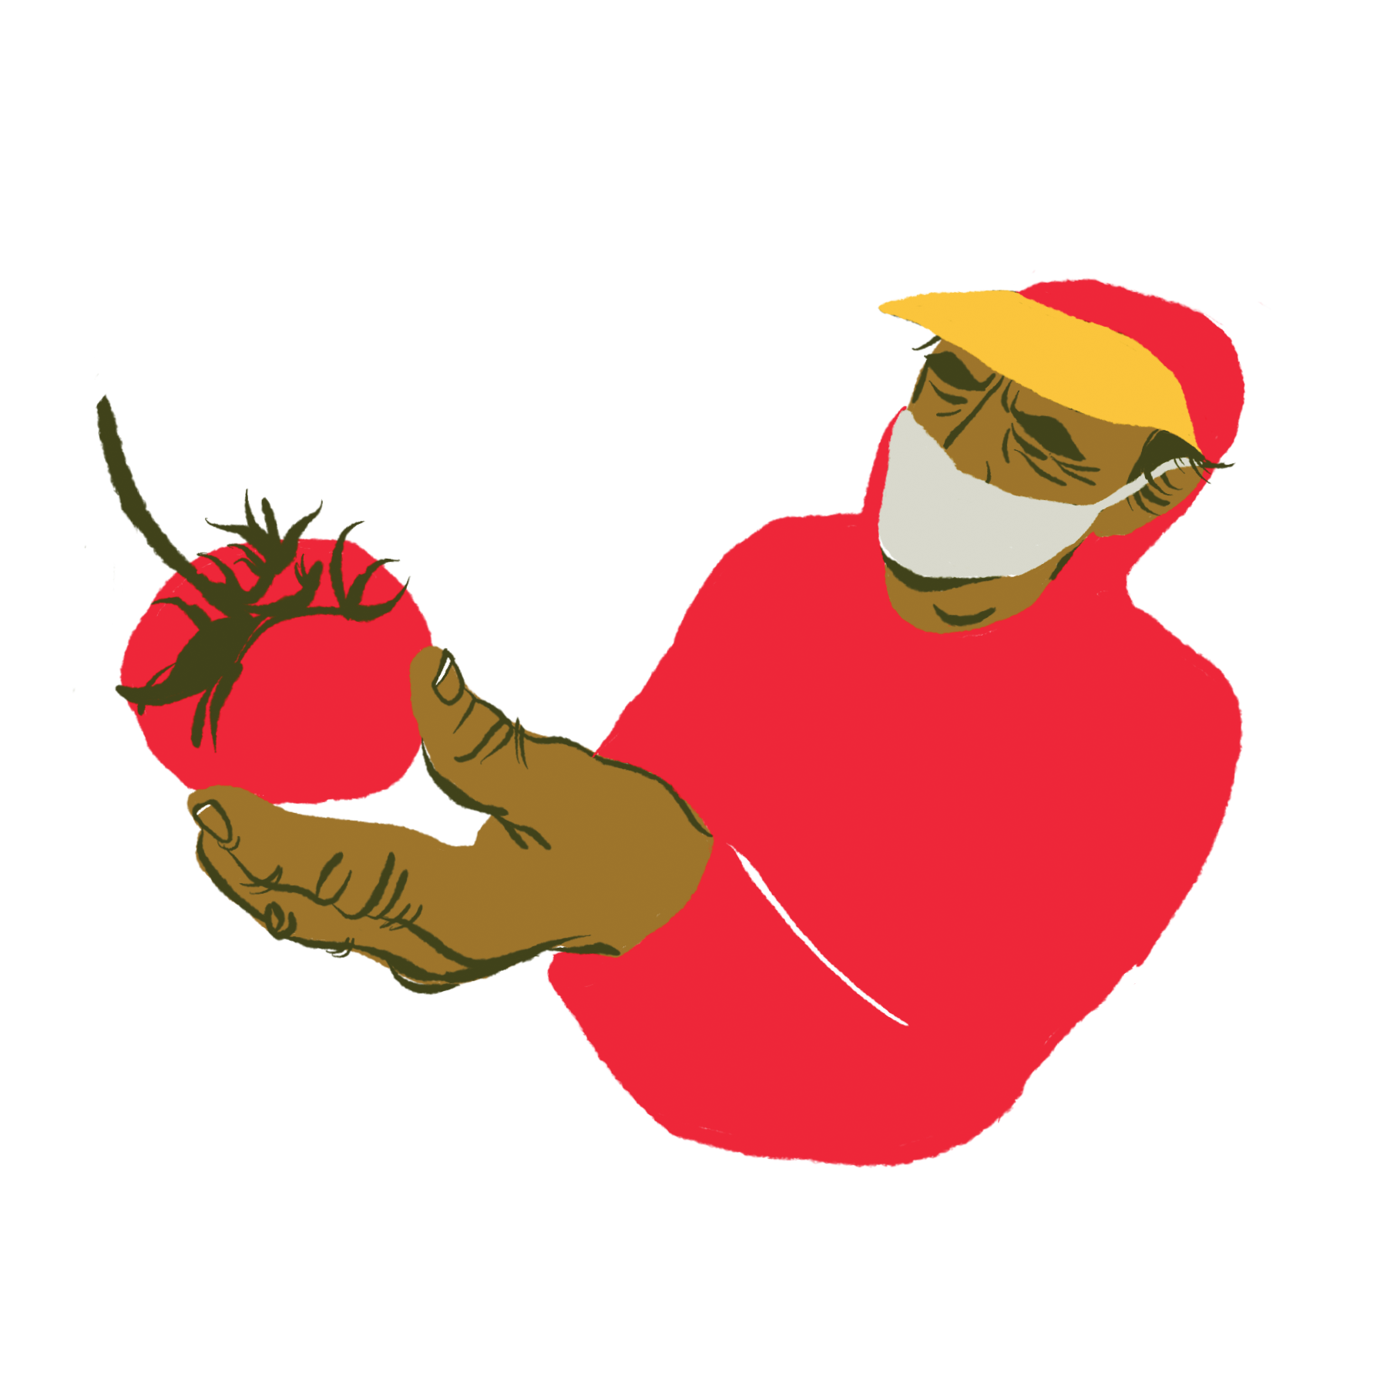
Messaging Strategies to Improve COVID-19 Vaccine Confidence in Agricultural Communities
Estrategias de mensajería para mejorar la confianza en la vacuna COVID-19 en las comunidades agrícolas
Presented by Robyn Correll, MPH, CHWI
on May 5, 2021

Slide 2
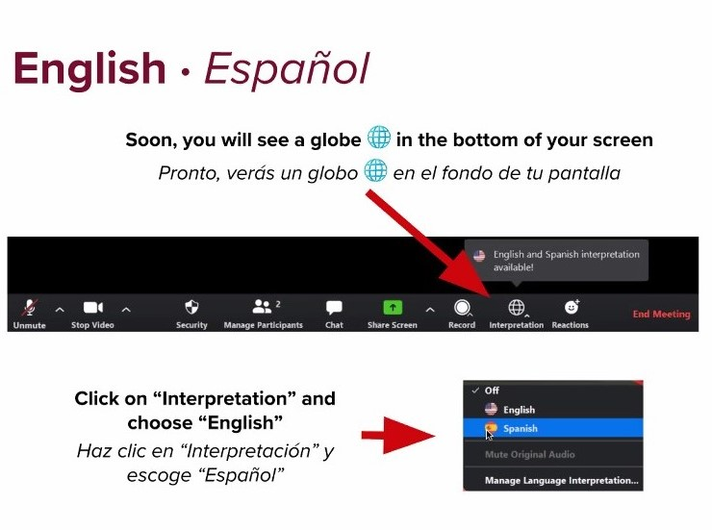
Interpretation
Interpretación

Slide 3
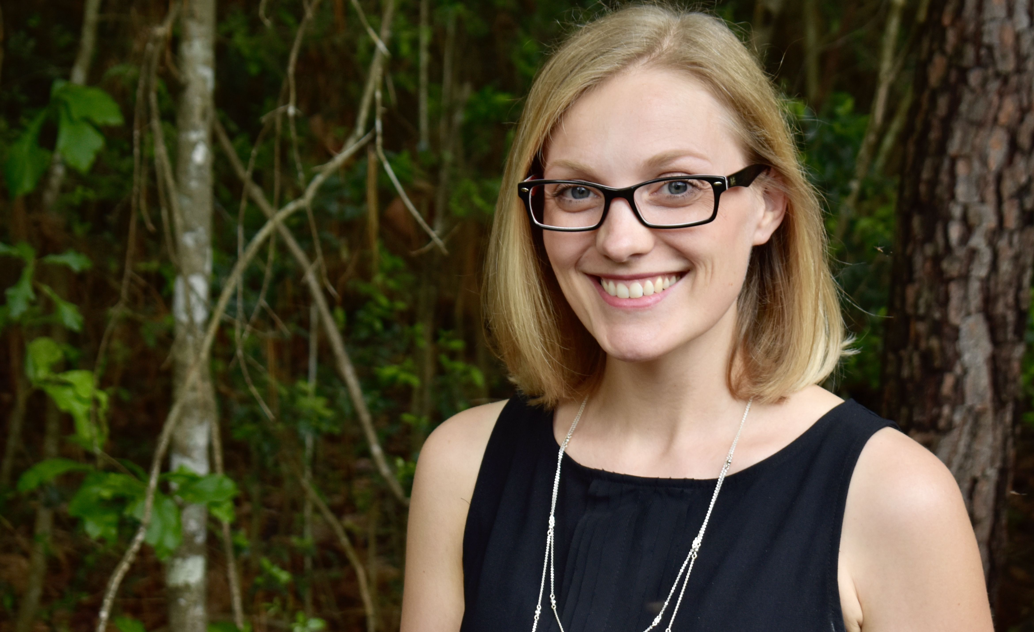
Robyn Correll, MPH, CHWI

Slide 4
Learning Objectives
Objetivos de Aprendizaje
Respond to questions or concerns about COVID-19 vaccines using research-aligned communication strategies, such as the CASE approach.
Discuss how vaccines are studied and monitored for safety in the U.S.
Explain the potential short- and long-term side effects of the COVID vaccines, why they happen and how they can be managed.
Describe what is known about COVID vaccines and fertility.
Discuss the use of fetal cells in vaccines and what religious groups have said about them.
Guide individuals on where and how they can get vaccinated against COVID-19, particularly if they do not have legal residency status or documentation.
Responder a preguntas o inquietudes sobre las vacunas COVID-19 utilizando estrategias alineadas con la investigación, como el enfoque CASE.
Discutir el proceso de cómo las vacunas son continuamente vigiladas para garantizar su seguridad en los EE. UU.
Explicar los posibles efectos secundarios a corto y largo plazo de las vacunas COVID, por qué ocurren y cómo se pueden controlar.
Describir lo que se sabe sobre las vacunas COVID y la fertilidad.
Hablar del uso de células fetales en las vacunas y lo que los grupos religiosos han dicho sobre ellas.
Navegar a las personas sobre dónde y cómo pueden vacunarse contra COVID-19, especialmente si no tienen un estatus de residencia legal o documentación.

Slide 5
Anyone over 16 is eligible to get vaccinated, including those without legal residency status or identification.
Cualquier persona mayor de 16 años se puede vacunar sin costo ni sin establecer documentos sobre su estatus residencia legal.
Notes:
Source: https://www.cdc.gov/coronavirus/2019-ncov/vaccines/faq.html#:~:text=Who%20is%20paying%20for%20the,Charge%20you%20for%20the%20vaccine
https://www.dhs.gov/news/2021/02/01/dhs-statement-equal-access-covid-19-vaccines-and-vaccine-distribution-sites

Slide 6
COVID-19 vaccines protect people from getting seriously sick or dying from COVID-19.
Las vacunas COVID-19 protegen a personas de enfermarse gravemente o morir a causa del COVID-19.

Slide 7
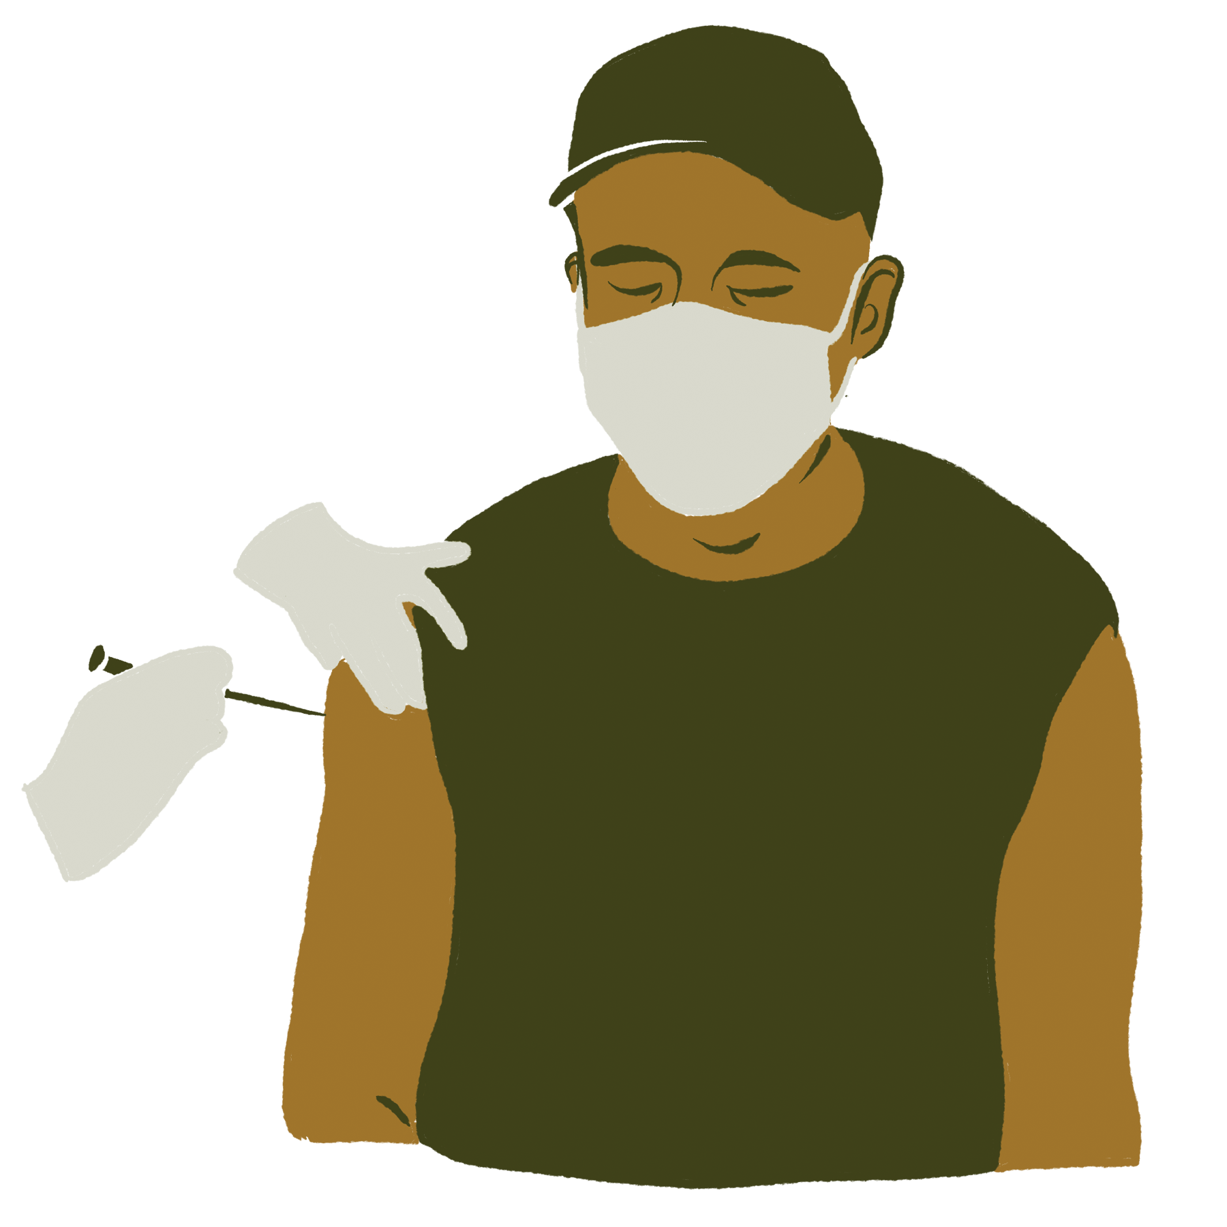
Pfizer
Moderna
Johnson & Johnson
16+
2 doses dosis
21 days días
mRNA vaccine
18+
2 doses dosis
28 days días
mRNA vaccine
18+
1 dose dosis
Viral vector vaccine
All three currently available COVID vaccines are very good at protecting people from hospitalization and death.
Las tres vacunas COVID disponibles son muy buenas para proteger a las personas de la hospitalización y la muerte.
Notes:
The reason Johnson and Johnson is 1 dose is because that’s what they found worked the best in clinical trials.
You might notice I don’t have effectiveness percentages on this slide. And the reason I don’t is because it’s very hard to compare them. They were all tested in clinical trials, but those clinical trials happened at different points in the pandemic. Pfizer’s trials, for example, happened in the fall, while Johnson & Johnson’s happened in the winter, after different versions of the virus started circulating. We know that some of the variants are a little smarter at getting around our body’s defenses, so it’s possible that if Pfizer’s or Moderna’s trial were to happen right now — or if Johnson & Johnson’s had been tested in the fall —they might have had a different effectiveness number. There were also differences in how they defined effective. As we get more information and more studies are done, we might get a better sense for how these vaccines compare. But right now, the important thing to note is that all three of these vaccines are phenomenal at protecting people from being hospitalized or dying from COVID. And that’s really the reason we vaccinate.
Info Sources: Cdc.gov/vaccines/covid-19/info-by-product/clinical-considerations.html
https://www.cdc.gov/coronavirus/2019-ncov/if-you-are-sick/end-home-isolation.html

Slide 8
Side effects
Efectos secundarios
In the arm where you got the vaccine:
Pain
Redness
Swelling
En el brazo donde recibió la vacuna:
Dolor
Enrojecimiento
Hinchazón
In the rest of your body:
Tiredness
Headache
Muscle pain
Chills
Fever
Nausea
En el resto de tu cuerpo:
Cansancio
Dolor de cabeza
Dolor muscular
Escalofríos
Fiebre
Náusea
Notes:
Source: CDC, https://www.cdc.gov/coronavirus/2019-ncov/vaccines/expect/after.html, https://www.cdc.gov/coronavirus/2019-ncov/vaccines/safety/adverse-events.html

Slide 9
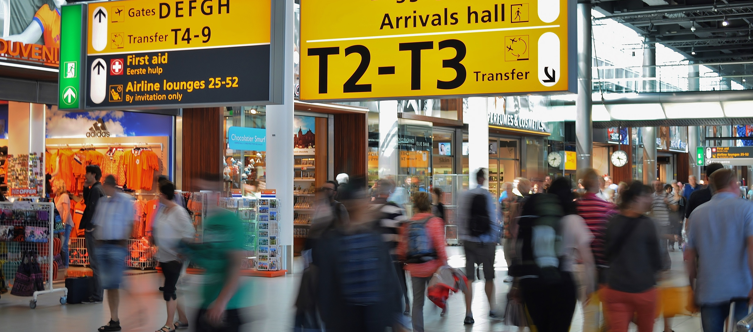
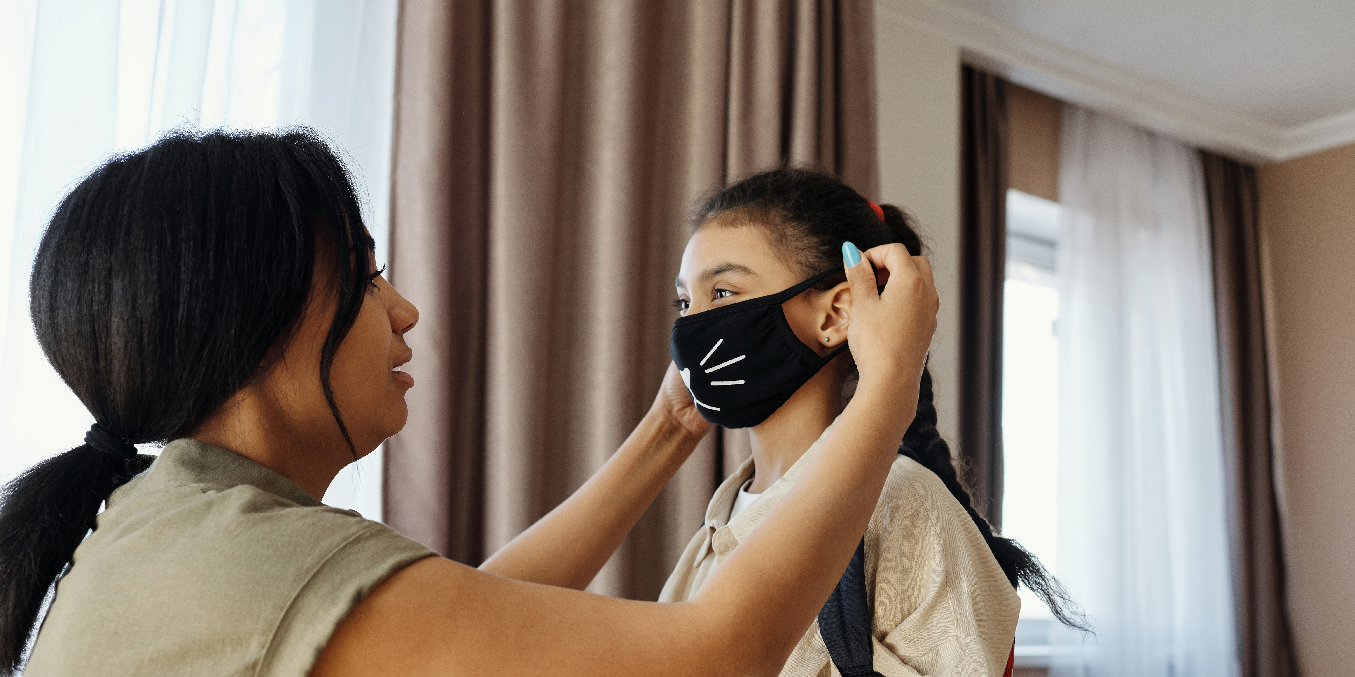
Two weeks after getting vaccinated, you can more safely…
Dos semanas después de vacunarse, puede con más seguridad ...
Gather indoors with vaccinated people without a mask or keeping 6 feet apart.
Reunirse en el interior con personas vacunadas sin máscara o con una distancia de 6 pies.
Gather outside without a mask, unless it’s crowded.
Reunirse afuera sin máscara, a menos que haya mucha gente.
Travel in the U.S. without needing to get tested or quarantine.
Viajar a los EEUU sin necesidad de hacerse la prueba ni de ponerse en cuarentena.
Be around other people even if you’ve been around someone with COVID-19
Estar cerca de otras personas incluso si ha estado cerca de alguien con COVID.
Notes:
Will cover the content laid out by the CDC here: https://www.cdc.gov/coronavirus/2019-ncov/vaccines/fully-vaccinated.html
Images are copyright free from Pexels.com:
https://www.pexels.com/photo/family-preparing-food-in-the-kitchen-4262010/
https://www.pexels.com/photo/two-women-with-man-hugging-by-the-sea-936018/
https://www.pexels.com/photo/people-sign-traveling-blur-2069/
https://www.pexels.com/photo/mother-putting-a-face-mask-on-her-daughter-4261252/

Slide 10
Getting vaccinate is a choice. And a lot can go into making that decision.
Graphics Source: UNICEF, Vaccine Misinformation Management Field Guide
Vacunarse es una decisión. Y muchas coses pueden influir en esa decisión.

Slide 11
Compassion Compasión
To improve vaccine confidence, you need:
Para mejorar la confianza en las vacunas, se necesita:
Trust
Confianza
Transparency
Transparencia
Notes:
Trust – the messenger is as important (if not more so) than the message. People believe information more if it comes from someone they trust.
Transparency – To have trust, we have to be trustworthy. That means being open and honest about what we know and don’t know and where we found the information.
Compassion – Remember, there’s a lot that goes into making a vaccine decision. It’s ok to have questions. It’s understandable that some are worried or afraid. People need to know that you get it. And that you know they are just trying to do what they think is the right thing for themselves or their families.
Our job is to help make sure that the decisions they do make, however, are not based on inaccurate information.
Info source: https://obssr.od.nih.gov/wp-content/uploads/2020/12/COVIDReport_Final.pdf
Images are copyright free from Pexels.com:
https://www.pexels.com/photo/selective-focus-photography-of-woman-1239288/
https://www.pexels.com/photo/shallow-focus-photo-of-white-open-sigange-3345876/
https://www.pexels.com/photo/hands-people-friends-communication-45842/

Slide 12
There is no “One Size Fits All” approach to increasing vaccine confidence.
No existe un enfoque universal para establecer la confianza en las vacunas.
Adapt the message (and messenger!) to the individual and circumstances.
Use a mix of storytelling and statistics.
Leave the door open for continued conversation.
Acknowledge that vaccination is ultimately a personal decision.
Adapte el mensaje (¡y el mensajero!) a la persona y las circunstancias.
Utilice una combinación de narraciones y estadísticas.
Deje la puerta abierta para continuar la conversación.
Reconozca que la vacunación es, en última instancia, una decisión personal.
Notes:
Info source: https://obssr.od.nih.gov/wp-content/uploads/2020/12/COVIDReport_Final.pdf

Slide 13
CASE Approach
Método CACE
C
Corroborate
Acknowledge their concern and find some point on which you can agree. Set the tone for a respectful, successful talk.
C
Corroborar
Reconozca su preocupación y encuentre algún punto en el que pueda estar de acuerdo. Establezca el tono para una charla exitosa y respetuosa.
A
About Me
Describe what you have done to build your knowledge base and expertise about their specific concern.
A
Acerca de mí
Describa lo que usted ha hecho para construir su base de conocimientos y experiencia sobre la preocupación específica.
S
Science
Describe what the science says in an accessible way. Be truthful and transparent. Avoid exaggerating benefits or minimizing risks.
C
Ciencias
Describa lo que dice la ciencia de forma accesible. Sea sincero y transparente. Evite exagerar los beneficios o minimizar los riesgos.
E
Explain/Advise
Give your recommendation, based on the science. Draw on positive emotions rather than fear or shame.
E
Explicar
Explique su recomendación, basado en la ciencia. Aproveche las emociones positivas en lugar del miedo o la vergüenza.
Source: Autism Science Foundation, Alison Singer
Notes:
Info source: https://njaap.org/uploadfiles/documents/f73.pdf
https://www.aap.org/en-us/advocacy-and-policy/aap-health-initiatives/immunizations/Pages/vaccine-hesitant-parents.aspx

Slide 14
“The vaccine was developed recently. How can we trust it?”
“La vacuna fue desarrollada muy pronto, como confiar?”

Slide 15
What do you think has to meet a higher standard for safety in the U.S.: Vaccines or vitamins?
¿Vacunas o vitaminas? ¿Cuál de los 2 tendrá que cumplir con estándares más alto de seguridad en los EEUU?
Vaccines. Vacunas.
Notes:
Info source: https://www.fda.gov/vaccines-blood-biologics/development-approval-process-cber/vaccine-development-101#:~:text=Standardized%20and%20validated%20tests%20are,people%20in%20the%20control%20group.
https://www.fda.gov/food/information-consumers-using-dietary-supplements/questions-and-answers-dietary-supplements

Slide 16
All vaccines must go through clinical trials before they can be used in the U.S.
PHASE 1
PHASE 2
PHASE 3
Todas las vacunas deben pasar por estudios clínicos antes de que se puedan usar en los EEUU.
Notes:
Before vaccines can be used, they have to be tested to make sure they’re safe and work like they’re supposed to. Researchers often start the testing in the laboratory — first in cells, then in animals. When they think they have a good vaccine candidate, they apply to test the vaccine in adult volunteers.
The first phase of human, or clinical, trials only involves a small number of people to make sure that the vaccine is safe and doesn’t cause any serious side effects. They also look at things like how the dose affects how the body responds. If everything looks good in this phase, then the candidate moves onto phase 2, which generally has a larger number of people. Hundreds instead of dozens. In this phase, researchers are looking at again 1. Is the vaccine safe? Are people responding to the vaccine by making antibodies? And 3. What are the side effects?
If the vaccine looks like it’s safe and works in that phase, then it will move onto phase 3 trials, which are typically really large — generally including thousands, if not tens of thousands of people, some of whom will get the vaccine, some of whom will get a placebo (like a shot of saline solution or another vaccine typically given to that age group). In this 3rd phase, researchers are looking at 1. is the vaccine safe, 2. does it work, and — most importantly — 3. how do the people who get the vaccine compare to those who didn’t? This 3rd phase tells us how effective the vaccine was at protecting people from getting seriously sick.
These phases are often done one right after another, but they don’t have to be. Sometimes, phases are combined — such as doing phase 1 and phase 2 at the same time. Or if the early trial results look good, then they might start recruiting volunteers for the next phase before the previous phase has totally wrapped up. But while these phases can overlap or be grouped together, none of them can be skipped. Even the COVID vaccines, which were developed in a very short amount of time, had to go through clinical trials before they could be used in the general public.
These clinical trials are crucial because they help answer an extremely important question: Do the benefits of the vaccine outweigh the risks? The answer has to be yes for the vaccine to be authorized in the U.S., and it’s a question we keep asking for as long as people get vaccinated.
Info source: https://www.fda.gov/vaccines-blood-biologics/development-approval-process-cber/vaccine-development-101#:~:text=Standardized%20and%20validated%20tests%20are,people%20in%20the%20control%20group.

Slide 17
Obstacles that usually slow down or stop other vaccines were removed, planned for, or mitigated for COVID vaccines.
Los obstáculos que generalmente suelen ser lentos o detienen otras vacunas se eliminaron, planificaron o mitigaron para las vacunas COVID.
Notes:
All of those factors came together to help clear away hurdles that usually slow down vaccine researchers and manufacturers.
Info sources: Children’s Hospital of Philadelphia, https://www.chop.edu/centers-programs/vaccine-education-center/making-vaccines/prevent-covid KHN, https://khn.org/news/test-sites-quickly-attract-thousands-for-covid-19-vaccine-study/
Nature, https://www.nature.com/articles/d41586-020-03626-1

Slide 18
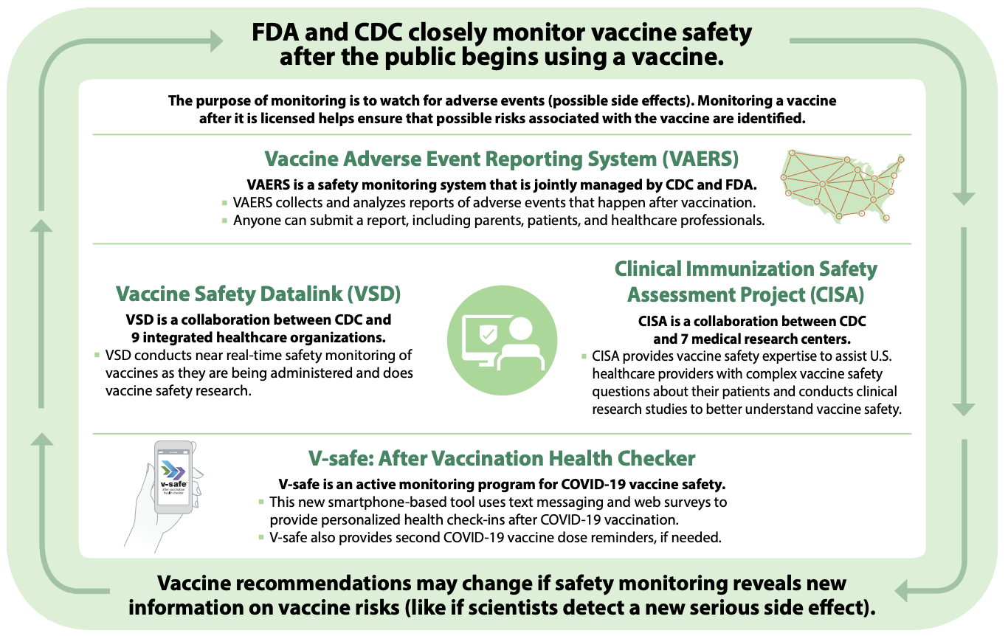
Multiple systems are set up to watch for extremely rare side effects.
Se configuran varios sistemas para detectar efectos secundarios raros.
Source: Centers for Disease Control and Prevention
Notes:
Source: CDC, https://www.cdc.gov/vaccines/covid-19/downloads/journey-of-covid-19-vaccine-508.pdf

Slide 19
Research must continue to show the benefits of a vaccine outweigh the risks.
Las investigaciones deben seguir demostrando que los beneficios de una vacuna superan los riesgos.
risks
riesgos
benefits
beneficios

Slide 20
“The vaccine was developed recently. How can we trust it?”
C
COVID vaccines were made really quickly compared to other vaccines. I was worried about that at first too.
corroborate
A
But then I went read about what all had to happen in order for the COVID vaccines to become available in the U.S.
about me
S
I learned that COVID vaccines had to go through the same safety testing that other vaccines go through. They were tested in tens of thousands of people. And now that they’re being used, multiple systems are set up to make sure the vaccines keep being safe. Millions of people have been vaccinated over the past few months, and all signs point to the benefits of the vaccine far outweighing the risks.
science
E
Learning that really calmed my mind. Given what we know about how serious COVID-19 can be, I’m really excited that we were able to get a vaccine as quickly as possible without sacrificing safety. I’ve gotten the vaccine, and I hope you will too.
explain

Slide 21
“La vacuna fue desarrollada muy pronto, como confiar?”
C
Las vacunas COVID se hicieron muy rápido en comparación con otras vacunas. Eso también me preocupó al principio.
corroborar
A
Pero leí sobre todo lo que tenía que suceder para que las vacunas COVID estuvieran disponibles en EEUU.
acerca de mí
Aprendí que las vacunas COVID tenían que pasar por las mismas pruebas de seguridad por las que pasan otras vacunas. Fueron probados en decenas de miles de personas. Y ahora que se están utilizando, se configuran varios sistemas para garantizar que las vacunas sigan siendo seguras. Millones de personas han sido vacunadas durante los últimos meses y todas las investigaciones muestran que los beneficios superan los riesgos.
C
ciencia
E
Eso me calmó. Dado lo que sabemos sobre lo que puede pasar con el COVID, estoy emocionada de que pudiéramos obtener una vacuna lo más rápido posible sin sacrificar la seguridad. He recibido la vacuna y espero que usted también la recibe.
explicar

Slide 22
“I’m worried about long-term side effects.”
“Me preocupan los efectos secundarios a largo plazo”.

Slide 23
“I’m worried about long-term side effects.”
C
COVID vaccines are new, so I understand the desire to want to “wait and see” what happens to others.
corroborate
A
I read a really great article by a vaccinologist on the Children’s Hospital of Philadelphia website. In it, he said while researchers are still doing studies to confirm, it’s highly unlikely that there will be any long-term or delayed side effects.
about me
S
In the 200 years we’ve been using vaccines, only a few have had any delayed or long-term side effects. And all of those were spotted within 8 weeks of the vaccine. What’s more, COVID vaccines might be new, but the technologies used to make the vaccines have been studied for years to prevent other diseases, and there haven’t been any warning signs that there are long-term side effects with those vaccines either.
science
E
I was really reassured by that — especially given how much we know about the long-term effects of COVID.
explain

Slide 24
“Me preocupan los efectos secundarios a largo plazo”.
C
Las vacunas COVID son nuevas, así que entiendo el deseo de esperar y ver lo que les sucede a los demás.
corroborar
A
Leí un artículo realmente excelente de un vacunólogo del Hospital Infantil de Filadelfia. En él, dijo, aunque los investigadores todavía están realizando estudios para confirmar que no hay efectos secundarios a largo plazo o tardios, es muy poco probable que los haya.
acerca de mí
C
En los 200 años que hemos estado usando vacunas, solo unas pocas han tenido efectos secundarios tardíos o a largo plazo. Y todos ellos fueron detectados dentro de las 8 semanas posteriores a la vacuna. Incluso, las tecnologías utilizadas para fabricar las vacunas se han estudiado durante años para prevenir otras enfermedades, y tampoco ha habido señales de advertencia de que esas vacunas tengan efectos secundarios a largo plazo.
ciencia
E
Eso me tranquiliza mucho, especialmente dado lo mucho que sabemos sobre los efectos a largo plazo de COVID.
explicar

Slide 25
“Is it true the Johnson & Johnson vaccine causes blood clots?”
"¿Es cierto que la vacuna Johnson & Johnson causa coágulos de sangre?"

Slide 26
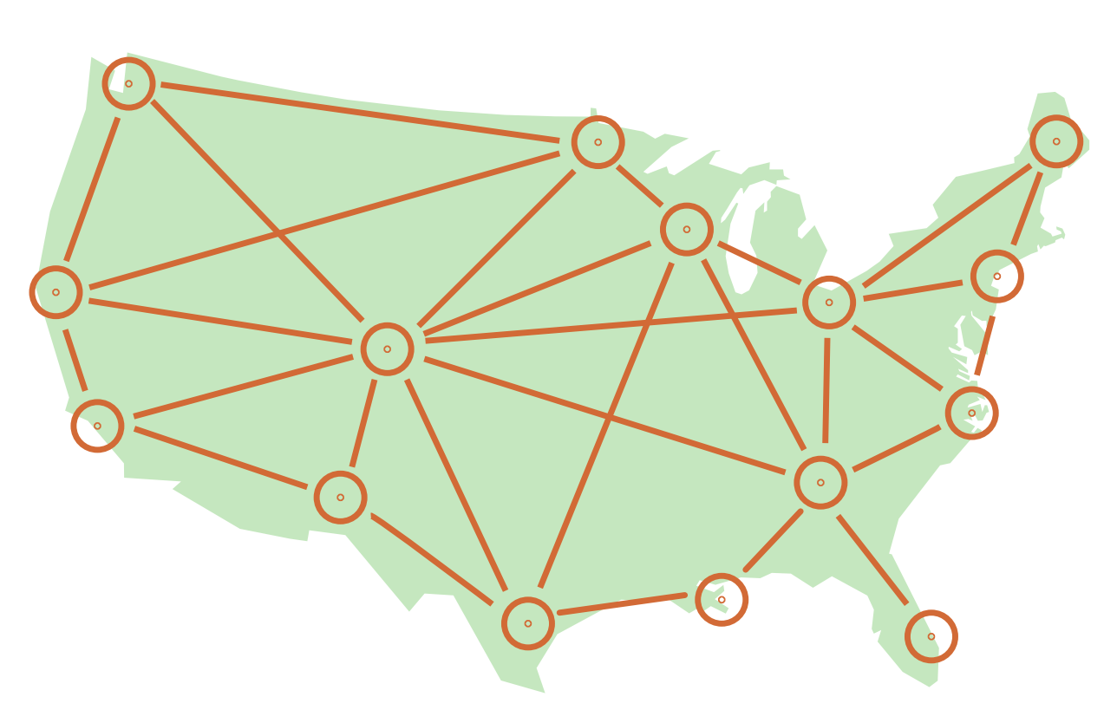
What happened?
¿Qué pasó?
Health officials called for a temporary pause:
To investigate
To alert medical providers and the public
Los funcionarios de salud pidieron una pausa temporal para:
Investigar
Alertar a los proveedores médicos y el público
6 cases of TTS
6 casos de TTS
TTS = Thrombosis with Thrombocytopenia Syndrome
Síndrome de trombosis con trombocitopenia
Notes:
Info source: https://www.cdc.gov/mmwr/volumes/70/wr/mm7018e2.htm

Slide 27
For every 1 million doses of J&J vaccine given, health experts expect...
Por cada millón de dosis de la vacuna J&J administradas, los expertos en salud esperarían...
6 deaths* prevented
&
297 hospitalizations* prevented
7 cases of TTS
6 muertes* evitadas
297 hospitalizaciones* evitadas
7 casos de TTS
benefits
risks
beneficios
riesgos
…among women 18-49 years
…entre mujeres 18-49 años de edad
*Due to COVID-19 por COVID-19
Data from Centers for Disease Control and Prevention, ACIP Meeting, April 23, 2021
Notes:
Info source: https://www.cdc.gov/vaccines/acip/meetings/downloads/slides-2021-04-23/06-COVID-Oliver-508.pdf
Health experts investigated and again asked the question: When we include this rare but serious side effect in our analysis, do the benefits of this vaccine still outweigh the risks?
And the answer they came to after hours of discussion was yes. Getting sick with COVID is still the much bigger risk, even for healthy young adults.
Health experts actually did a lot of math to help answer this risk vs. benefits question. They looked at, given what we know, how many cases of TTS (the rare blood clots with low platelets) would we expect for every 1 million doses of the vaccine, compared to how many deaths or hospitalizations would we expect due to COVID in that same population.
Even when we look at the group most at risk for this particular condition after getting the J&J vaccine — that is, women ages 18-49 — the benefits clearly outweigh the risks. The vaccine would lead to an estimated 7 cases of TTS, but it would prevent 6 deaths and nearly 300 hospitalizations.
The numbers were even more clear for other groups like women over 50 and adult men of any age.
This is what led health experts to lift the pause and start vaccinating again. COVID is still very much here and it’s still hurting a lot of people. So while the J&J vaccine might lead to this very rare risk, it would also protect a lot more people from getting seriously sick or dying from COVID.

Slide 28
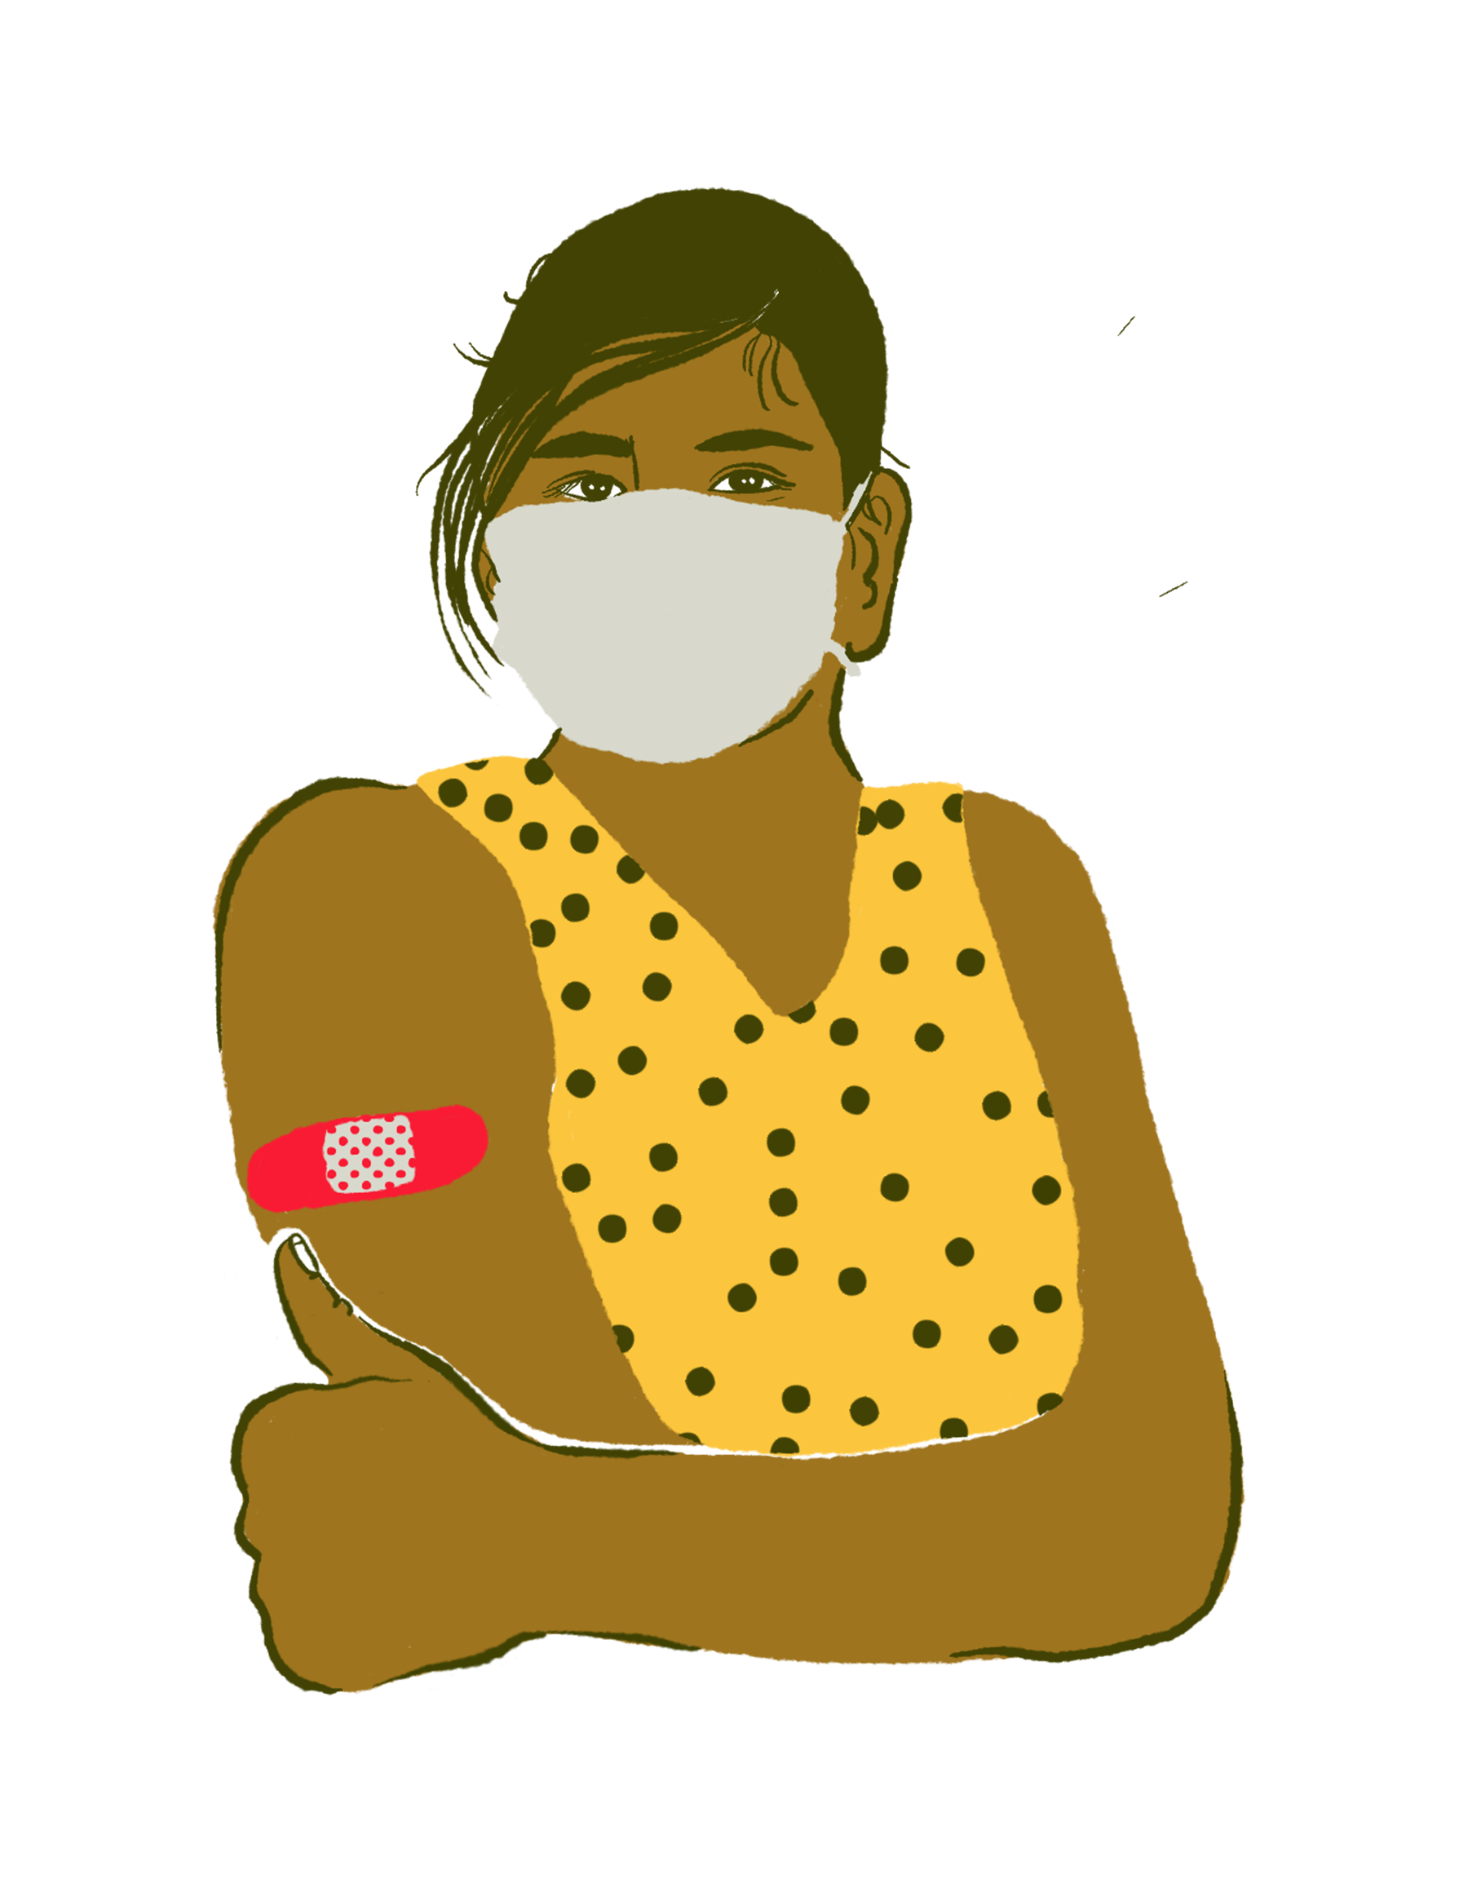
If you got the J&J vaccine:
Si recibió la vacuna J&J:
Stay calm. The risk is very small, and the condition is treatable.
Watch out for the following signs for 3 weeks after getting the vaccine:
Severe headache
Backache
New neurologic symptoms
Severe abdominal pain
Leg pain or swelling
Tiny red spots on the skin
New or easy bruising
Shortness of breath
Mantenga la calma. El riesgo es muy pequeño y la afección se puede tratar.
Prestar atención a los siguientes signos durante las 3 semanas después de recibir la vacuna:
Dolor de cabeza intenso
Dolor de espalda
Nuevos síntomas neurológicos
Dolor abdominal severo
Dolor o hinchazón en las piernas
Pequeñas manchas rojas en la piel.
Moretones nuevos o fáciles
Dificultad para respirar
Notes:
Info Source: https://www.cdc.gov/coronavirus/2019-ncov/vaccines/safety/JJUpdate.html#symptoms-list

Slide 29
“Is it true the Johnson & Johnson vaccine causes blood clots?”
C
There has been a lot in the news about that. Some people had a rare but serious type of blood clot combined with low blood platelets after getting the Johnson & Johnson vaccine.
corroborate
A
I was recently in a training that talked about what happened and what’s going on.
about me
S
Investigators are looking into it. It’s serious but also extremely rare. When health experts ran the numbers, they found that even with the rare of chance of this condition, you’re still way more likely to be hospitalized or die if you get COVID.
science
E
That said, if you’re still not comfortable, you could always try to get a different COVID vaccine like the ones from Pfizer and Moderna. This issue hasn’t been seen in people who got those vaccines. The Call for Health line could help you find out which sites carry which vaccines. Would you like me to call with you?
explain

Slide 30
"¿Es cierto que la vacuna Johnson & Johnson causa coágulos de sangre?"
C
Ha habido muchas noticias sobre eso. Algunas personas tuvieron un tipo de coágulo sanguíneo poco común pero grave combinado con niveles bajos de plaquetas después de recibir la vacuna Johnson & Johnson.
corroborar
A
Recientemente estuve en una capacitación que habló sobre lo que pasó y lo que está sucediendo.
acerca de mí
C
Se está investigando. La condición es seria pero también extremadamente raro. Cuando los expertos en salud calcularon los números, descubrieron que incluso con la rara posibilidad de padecer esta afección, es mucho más probable que uno se hospitalicen o muera si contrae COVID.
ciencia
E
Pero si aún no se siente cómodo, siempre puede obtener otro tipo de vacuna COVID como las de Pfizer y Moderna. Este problema no se ha observado en personas que recibieron esas vacunas. La línea Una Voz Para la Salud podría ayudarle a averiguar qué sitios tienen qué vacunas. ¿Quiere llamarlo conmigo?
explicar

Slide 31
“I’m scared it will make me infertile.”
"Tengo miedo de que me haga infértil".

Slide 32
“I’m scared it will make me infertile.”
C
I’ve seen a lot of posts about that on social media, and I can understand why you’re concerned.
corroborate
A
I was too, so I tried to find out everything I could about how the COVID vaccines work and what the research has shown so far.
about me
And there isn’t any evidence that vaccines — any vaccines — affect fertility. The reason some people think that is because the spike proteins around the virus are similar in some ways to proteins on the placenta where a baby develops during pregnancy. So they’re worried that if our bodies learn to attack the COVID virus, then it will attack those placental proteins and lead to infertility. But our bodies are smarter than that and can tell the difference. Many people have gotten vaccinated during pregnancy now and have gone on to have healthy babies.
S
science
E
Some people put out these messages because they want to scare others away from getting vaccinated. But all the research so far continue to show that the vaccines don’t affect fertility. What they can do is protect you from COVID.
explain

Slide 33
"Tengo miedo de que me haga infértil".
C
He visto muchas publicaciones sobre eso en las redes sociales y puedo entender por qué le preocupa.
corroborar
A
Me preocupó también, así que traté de averiguar todo lo que pude sobre cómo funcionan las vacunas COVID y qué ha demostrado las investigaciones hasta ahora.
acerca de mí
Y no hay ninguna evidencia de que las vacunas, cualquier vacuna, afecten la fertilidad. La razón por la que algunas personas piensan eso es porque las proteínas de pico alrededor del virus son similares a las proteínas de la placenta donde se desarrolla el bebé durante el embarazo. Por eso les preocupa que si nuestros cuerpos aprenden a atacar el virus COVID, atacará esas proteínas placentarias y conducirá a la infertilidad. Pero nuestros cuerpos son más inteligentes que eso y pueden notar la diferencia. Muchas personas se han vacunado durante el embarazo y ahora tienen bebés sanos.
C
ciencia
E
Algunas personas envían estos mensajes porque quieren asustar a otros para que no se vacunen. Pero todas las investigaciones hasta ahora continúan mostrando que las vacunas no afectan la fertilidad. Lo que pueden hacer es protegerle contra el COVID.
explicar

Slide 34
“How can we determine which vaccine to choose?”
"¿Cómo podemos determinar qué vacuna elegir?"

Slide 35
“How can we determine which vaccine to choose?”
C
It’s great that you want to get vaccinated!
corroborate
A
When I was trying to figure out where and how to get vaccinated, I looked into how effective the vaccines were at protecting people.
about me
S
And I found out that while there are pros and cons to each of them, all three of the vaccines available are safe and really good at protecting people from getting seriously sick or dying from COVID.
science
E
That was the most important thing to me. So the next question I asked myself was, “Where can I get vaccinated soonest?” And that’s how I chose which vaccine to get. What’s the most important thing to you?
explain

Slide 36
"¿Cómo podemos determinar qué vacuna elegir?"
C
¡Que bueno que usted quiere vacunarse!
corroborar
A
Cuando yo estaba tratando de averiguar dónde y cómo vacunarme, miré qué tan efectivas eran las vacunas para proteger a las personas.
acerca de mí
C
Y descubrí que, mientras hay ventajas y desventajas para cada una de ellas, las tres vacunas disponibles son seguras y realmente buenas para proteger a las personas de enfermarse gravemente o morir de COVID.
ciencia
E
Eso fue lo más importante para mí. Entonces, la siguiente pregunta que me hice fue: "¿Dónde puedo vacunarme lo antes posible?" Y así es como elegí cuál vacuna ponerme. ¿Qué es lo más importante para usted?
explicar

Slide 37
“How are we going to protect ourselves against the new variants of COVID?”
"¿Cómo nos vamos a proteger contra las nuevas variantes de COVID?"

Slide 38
“How are we going to protect ourselves against the new variants of COVID?”
C
This is an important question!
corroborate
A
The good news is that everything I’ve heard from scientists and health experts is that there’s a pretty straightforward answer.
about me
The more people who get COVID, the more opportunity the virus has to change. So the best way to protect ourselves from these variants is by preventing COVID altogether in as many people as possible. That means getting vaccinated and continuing to take precautions like wearing masks when you’re around other people and avoiding crowds.
S
science
E
The variants can be tricky, but research so far shows the vaccines do help protect us against getting seriously sick or dying from them. Have you thought about where and how to get vaccinated? Would you like my help scheduling you an appointment?
explain
Notes:
Info source: https://jamanetwork.com/journals/jama/fullarticle/2777785

Slide 39
“La vacuna fue desarrollada muy pronto, como confiar?”
C
¡Esta es una pregunta importante!
corroborar
A
La buena noticia es que todo lo que he escuchado de científicos y expertos en salud es que hay una respuesta bastante sencilla.
acerca de mí
Cuantas más personas contraigan COVID, más oportunidades tiene el virus de cambiar. Entonces, la mejor manera de protegernos de estas variantes es previniendo el COVID por completo en tantas personas como sea posible. Eso significa vacunarse y seguir tomando precauciones, como cubrir la boca y nariz cuando está cerca de otras personas y evitar las multitudes.
C
ciencia
E
Las variantes pueden ser complicadas, pero las investigaciones hasta ahora muestran que las vacunas ayudan a protegernos de enfermarnos gravemente o morir a causa de las variantes. ¿Ha pensado dónde y cómo vacunarse? ¿Le gustaría mi ayuda para conseguir una cita?
explicar

Slide 40
“I heard that they use aborted fetuses in the COVID vaccines.”
"Escuché que usan fetos abortados en las vacunas COVID".

Slide 41
Anti-vaccine activists push this message because they know it upsets people.
Los activistas contra las vacunas empujan este mensaje porque saben que molesta a la gente.
No COVID vaccines have fetal cells in them.
The J&J vaccine uses cells from a fetal cell line to grow the adenovirus used in the vaccine. But the cells themselves aren’t in the vaccine.
The cells originally came from a small number of pregnancies that ended decades ago.
Ninguna vacuna COVID contiene células fetales.
La vacuna J&J usa células de una línea celular fetal para hacer crecer el adenovirus que se usa en la vacuna. Pero las células mismas no están en la vacuna.
Las células provienen originalmente de una pequeña cantidad de embarazos que terminaron hace décadas.

Slide 42
“I heard that they use aborted fetuses in the COVID vaccines.”
C
I’ve seen posts about that on Facebook. Some of the images and language used in the posts were really upsetting.
corroborate
A
So I looked into where those rumors came from and whether COVID vaccines use fetal cells.
about me
And I found out that there aren’t any fetal cells in COVID vaccines. The Johnson & Johnson vaccine uses a fetal cell line — which are cells that have been grown in a laboratory for decades — to make the virus they use in the vaccine. But cells aren’t actually in the vaccine. Anti-vaccine activists push out messages like these because they know it upsets people, and they’re hoping it will push them away from getting vaccinated.
S
science
E
If you’re really uncomfortable about the idea though, you could try and get one of the mRNA vaccines. Fetal cells aren’t used at all to make the Pfizer or Moderna COVID vaccines.
explain

Slide 43
"Escuché que usan fetos abortados en las vacunas COVID".
C
He visto publicaciones sobre eso en Facebook. Algunas de las imágenes y el lenguaje utilizado en las publicaciones fueron realmente molestos.
corroborar
A
Así que investigué de dónde provenían esos rumores y si las vacunas COVID usan células fetales.
acerca de mí
Y descubrí que no hay células fetales en las vacunas COVID. La vacuna Johnson & Johnson usa una línea celular fetal, que son células que se han cultivado en un laboratorio durante décadas, para producir el virus que usan en la vacuna. Pero las células en realidad no están en la vacuna. Los activistas en contra de las vacunas difunden mensajes como estas porque saben que molestan a la gente y esperan que los aleje de vacunarse.
C
ciencia
E
Sin embargo, si está incómodo con la idea, puede intentar obtener una de las vacunas de ARNm. Las células fetales no se utilizan para fabricar las vacunas COVID de Pfizer o Moderna.
explicar

Slide 44
“Is it true that the vaccine contains microchips?”
"¿Es cierto que la vacuna contiene microchips?"

Slide 45
“Is it true that the vaccine contains microchips?”
C
I’ve heard that from some other people too, and I can see why the idea would be really concerning.
corroborate
A
I reached out to a vaccine scientist who works at Baylor College of Medicine, and I asked her if it was possible to put microchips in a vaccine or how that would work.
about me
S
And she said that it would be pretty much impossible to get a microchip in a vaccine because the needles they use are so small. Health officials do have a way to keep track of who gets vaccinated, but that’s through electronic health records and you don’t have to give them permission to put your information in those systems if you don’t want them to.
science
E
When I got vaccinated, they gave me a consent form to fill out to have my information put into the state’s immunization registry, but it wasn’t required to get the vaccine. Would you like me to show what form I mean?
explain

Slide 46
"¿Es cierto que la vacuna contiene microchips?"
C
También he escuchado eso de otras personas y puedo ver por qué la idea sería preocupante.
corroborar
A
Me comuniqué con una científica de vacunas que trabaja en Baylor College of Medicine y la pregunté si era posible poner microchips en una vacuna o cómo funcionaría.
acerca de mí
C
Y dijo que sería prácticamente imposible poner un microchip en una vacuna porque las agujas que usan son demasiado pequeñas. Los funcionarios de salud tienen una forma de realizar un seguimiento de quién se vacuna, pero eso es a través de registros de salud electrónicos y no tiene que darles permiso para poner su información en esos sistemas si no lo desea.
ciencia
E
Cuando me vacuné, me dieron un documento de consentimiento para completar para que mi información se ingresara en el registro de vacunación, pero no era necesario para recibir la vacuna. ¿Quiere que le muestre de qué forma me refiero?
explicar

Slide 47
“I am scared when they ask to provide social security because I don’t have migratory status.”
"Me da miedo cuando me piden que brinde mi Seguro Social porque no tengo estatus migratorio".

Slide 48
“I am scared when they ask to provide social security because I don’t have migratory status.”
C
I’m so sorry. I know how scary it must be when someone asks you to provide social security.
corroborate
A
I confirmed that the Department of Homeland Security says that...
about me
You can absolutely get the COVID vaccine even if you’re undocumented. ICE and U.S. Customs and Border Protection aren’t supposed to take people into custody at clinics or anywhere people get medical care. There might federal officials at vaccination sites, but they are only there to get people vaccinated, and you shouldn’t be turned away if you don’t have an official ID or social security number.
S
science
E
Would you like me to come with you to the vaccination site?
explain
Notes:
https://www.dhs.gov/news/2021/02/01/dhs-statement-equal-access-covid-19-vaccines-and-vaccine-distribution-sites

Slide 49
"Me da miedo cuando me piden que brinde mi Seguro Social porque no tengo estatus migratorio".
C
Lo siento mucho. Sé lo aterrador que debe ser cuando alguien le pide que proporcione su Seguro Social.
corroborar
A
Confirmé que el Departamento de Seguridad Nacional dice que ...
acerca de mí
Todos pueden recibir la vacuna COVID — incluso los que no tienen documentación oficial. ICE no se supone detener a personas en clínicas o en cualquier lugar donde las personas reciban atención médica. Es posible que haya funcionarios federales en los sitios de vacunación, pero solo deben estar allí para vacunar a las personas, y no debe ser rechazado si no tiene una identificación oficial o un número de seguro social.
C
ciencia
E
¿Quieres que le acompañe al lugar de la vacunación?
explicar

Slide 50
“What do I do if I had one dose of AstraZeneca in another country?”
"¿Qué hago si recibí una dosis de AstraZeneca en otro país?"
We don’t have any data on how effective it is to start with one vaccine and end with another. So health officials recommend you get re-vaccinated with a vaccine that is authorized in the U.S.
No tenemos datos sobre qué tan efectivo es comenzar con una vacuna y terminar con otra. Por lo tanto, los funcionarios de salud recomiendan que se vuelva a vacunar con una vacuna autorizada en EEUU.

Slide 51
“When will kids be able to get the vaccine?”
"¿Cuándo podrán los niños recibir la vacuna?"
There’s no hard timeline yet, but hopefully soon for those ages 12-16! Clinical trials are still underway for younger kids. It might not be until next year that we get vaccines for kids under 12.
Todavía no hay un cronograma estricto, ¡pero esperamos que pronto para las edades de 12 a 16 años! Los estudios clínicos todavía están en curso para niños más pequeños. Es posible que no sea hasta el próximo año que recibamos vacunas para niños menores de 12 años.

Slide 52
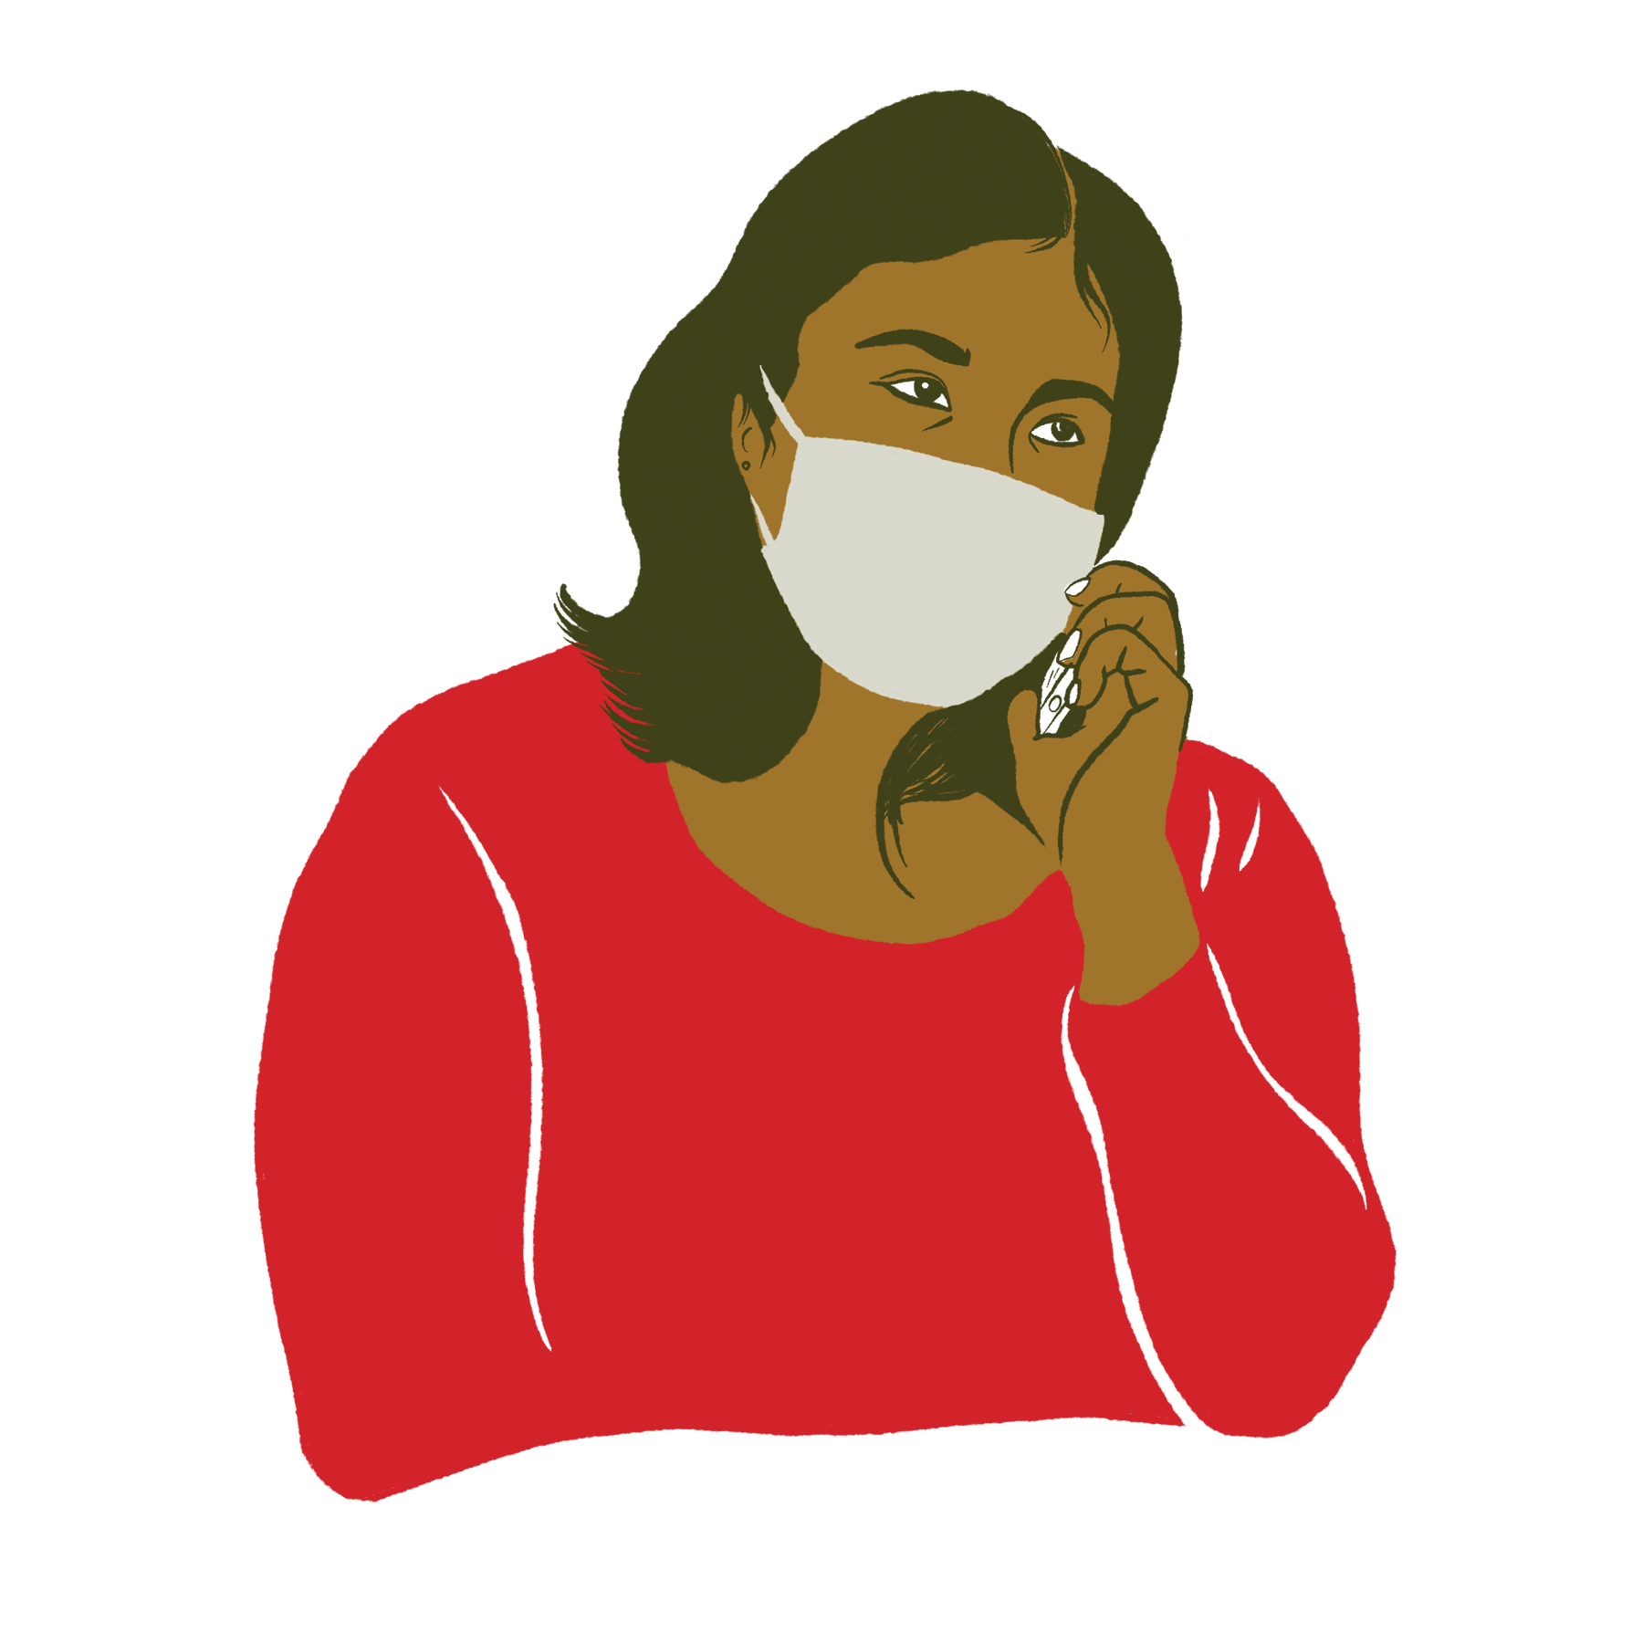
What to do when you don’t know they’re concern.
Qué hacer cuando no sabe que les preocupa.
“May I ask why?”
“Can you tell me more about that?”
“May I ask where you heard that?”
“Is there something that’s worrying you about it?”
"¿Puedo preguntar por qué?"
"¿Me puede decir más sobre eso?"
"¿Puedo preguntar dónde escuchaste eso?"
"¿Hay algo que te preocupe?"

Slide 53
What to say when you don’t know the answer.
Qué decir cuando usted no sabe la respuesta.

Slide 54
“I’ve heard that the vaccine… [new concern]. Is that true?”
C
I hadn’t heard that before, but I can see why you’d be concerned.
corroborate
A
Let me do a little more research about that.
about me
S
And I’ll let you know what I find.
science
E
What’s the best way to get back to you?
explain

Slide 55
“He escuchado que la vacuna… [duda nueva]. ¿Es cierto?”
C
No he escuchado eso, pero puedo ver por qué usted estaría preocupado.
corroborar
A
Por favor, déjeme investigar un poco más sobre eso.
acerca de mí
C
Y le haré saber lo que encuentro.
ciencia
E
¿Cuál es la mejor manera de contactarle?
explicar

Slide 56
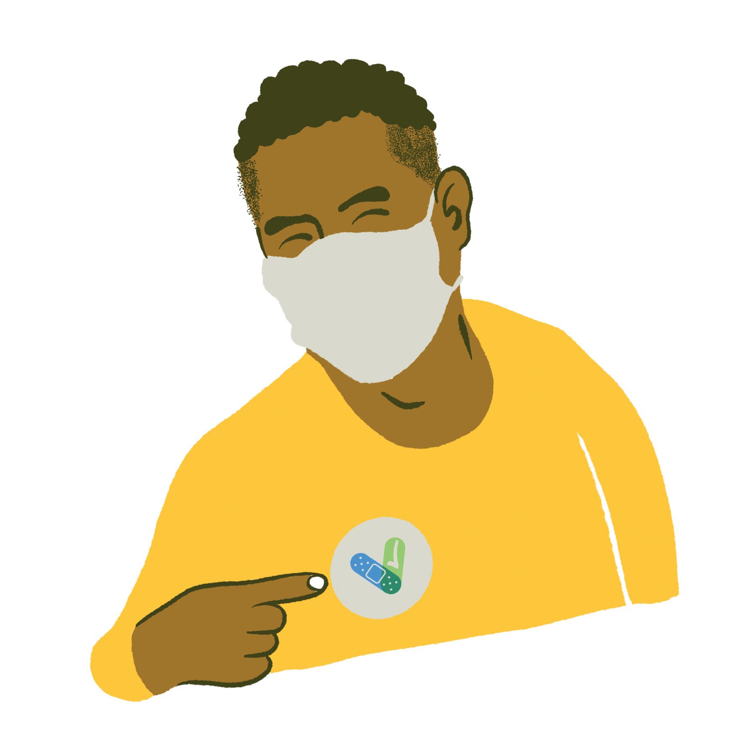
Remember
Recuerde
These conversations happen one person at a time.
Some people have more than one concern, and that’s OK.
You might need to have multiple conversations with someone before they start to feel more comfortable.
Adapt your message/approach to the person you’re talking to.
If things get heated, just let them know that you care about them and that you’re there for them.
Estas conversaciones ocurren de una persona a la vez.
Algunas personas tienen más de una preocupación y eso está bien.
Es posible que deba tener varias conversaciones con alguien antes de que comience a sentirse más cómodo.
Adapte su mensaje / enfoque a la persona.
Si las cosas se calientan, recordarles que le importa a usted y que usted está allí para ayudarlos.

Slide 57
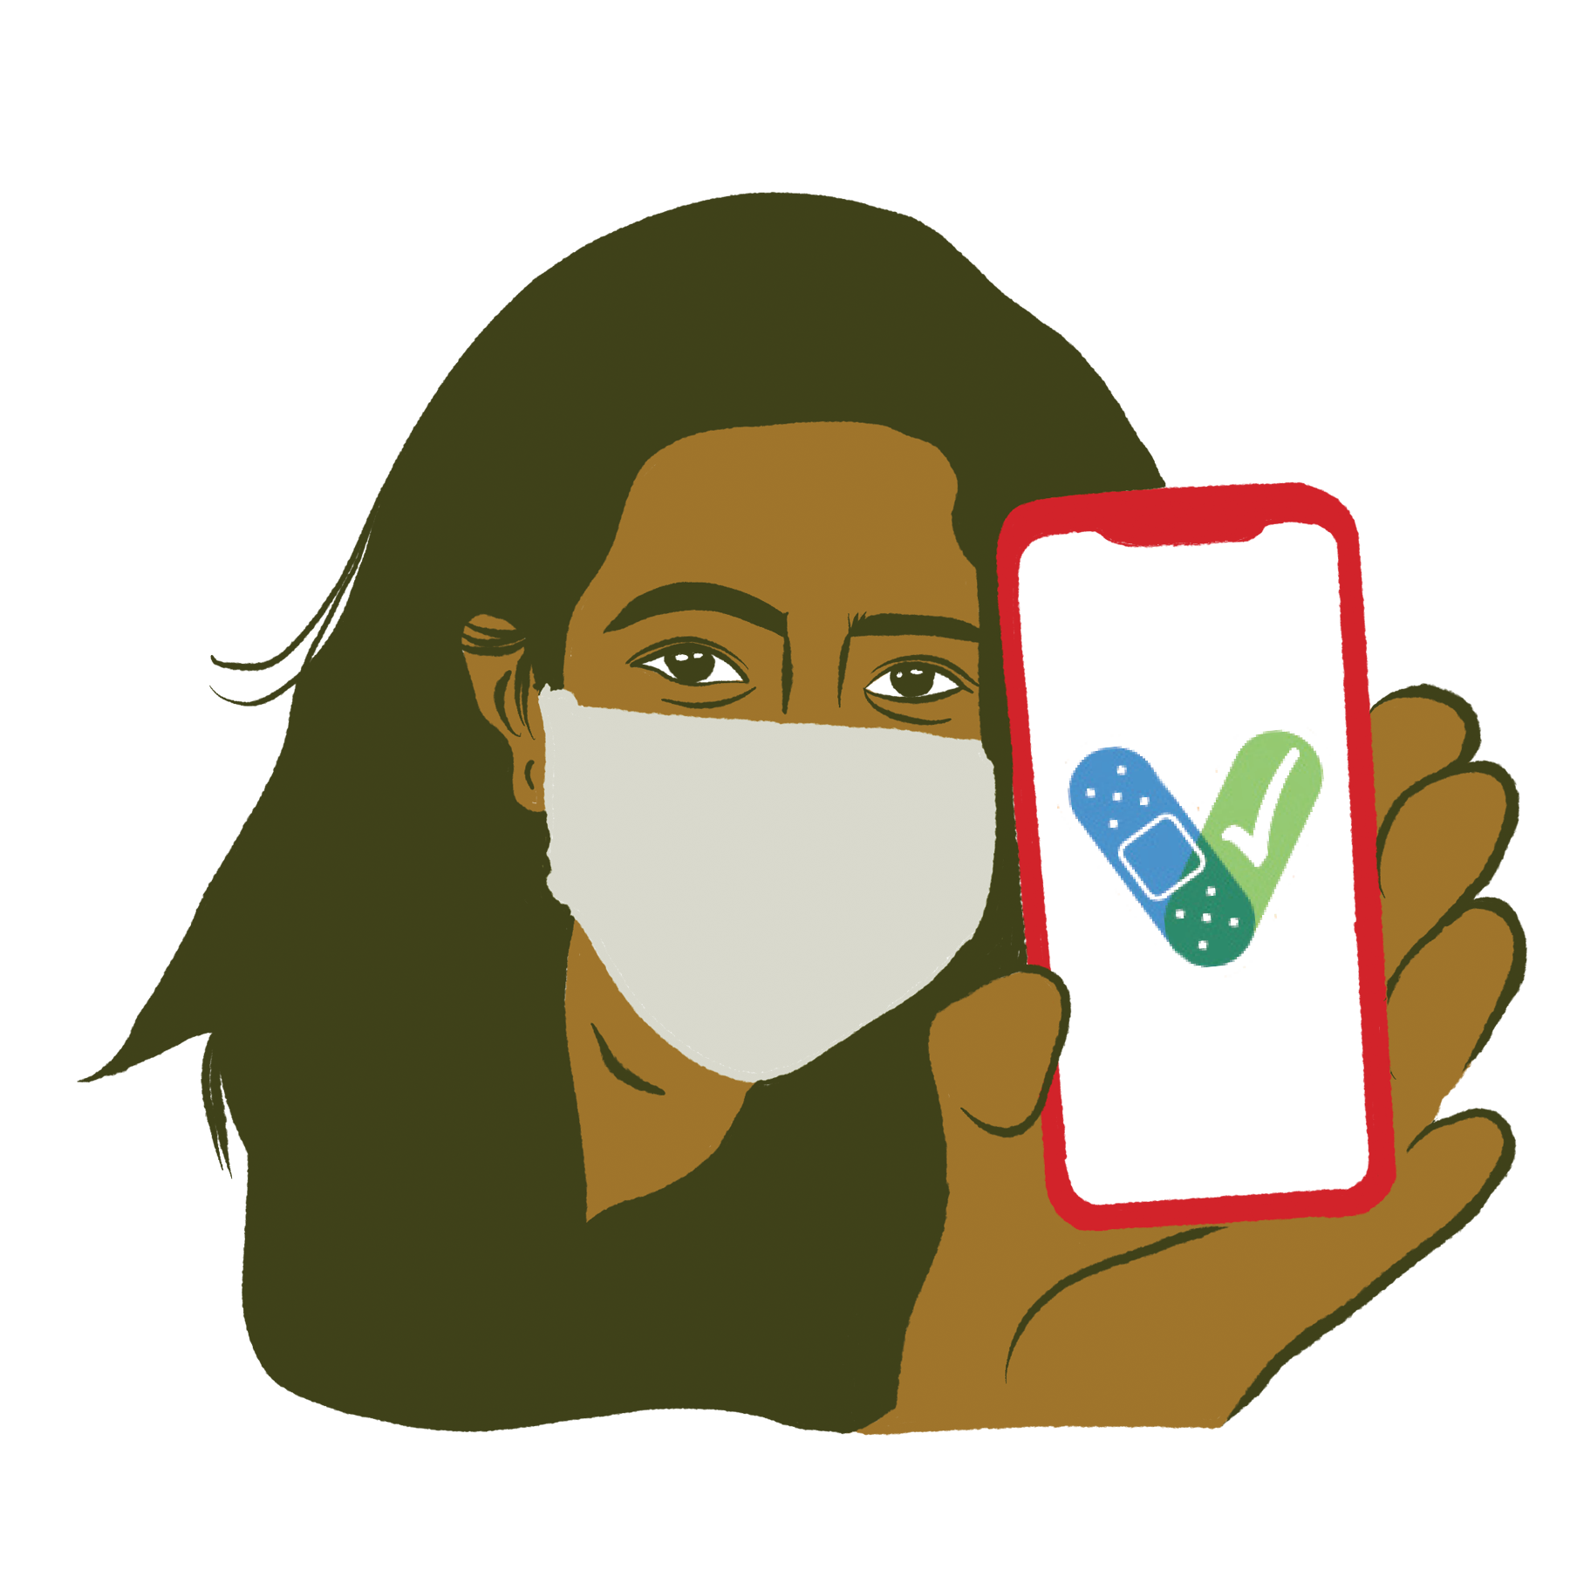
1-800-377-9968

Slide 58
Thank you to Gracias a
Claudia Gizell Aparicio Gamundi

Slide 59
Resources
Centers for Disease Control and Prevention Cdc.gov/vaccines/covid-19/
Cdc.gov/vaccines/covid-19/info-by-product/clinical-considerations.html
Children’s Hospital of Philadelphia
Chop.edu/centers-programs/vaccine-education-center/
Vaccinate Your Family
Vaccinateyourfamily.org/covid19
Vaccine Finder
Vaccines.gov/

